Slide 1

Analyzing and Forecasting Commodity Price Trends Using Data-Driven Models
Gold, Silver, Copper, Palladium, and Platinum (2000–2024)
Rishav Mondal
Soumyabrata Ghosh

Slide 2
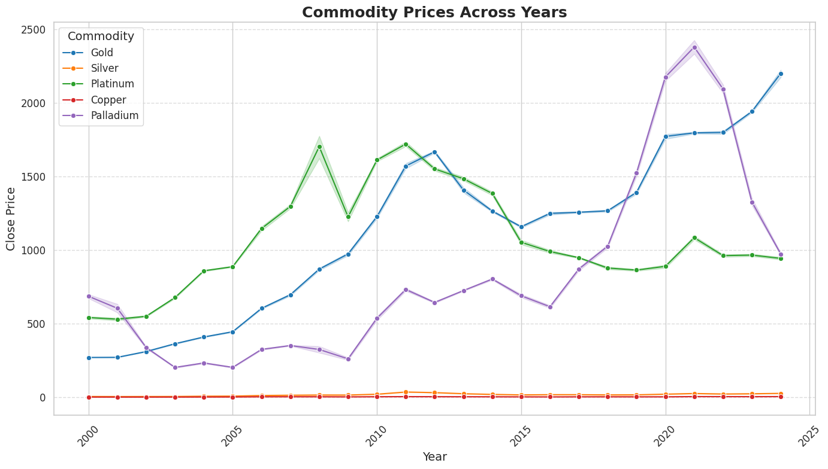
Introduction
Importance
Commodities are essential components of the global economy, driving energy, manufacturing, and trade.
Objectives
1. Analyzing trends between 2000-2024
2. Assessing Correlations between commodities.
3. Developing Models to forecast future prices

Slide 3
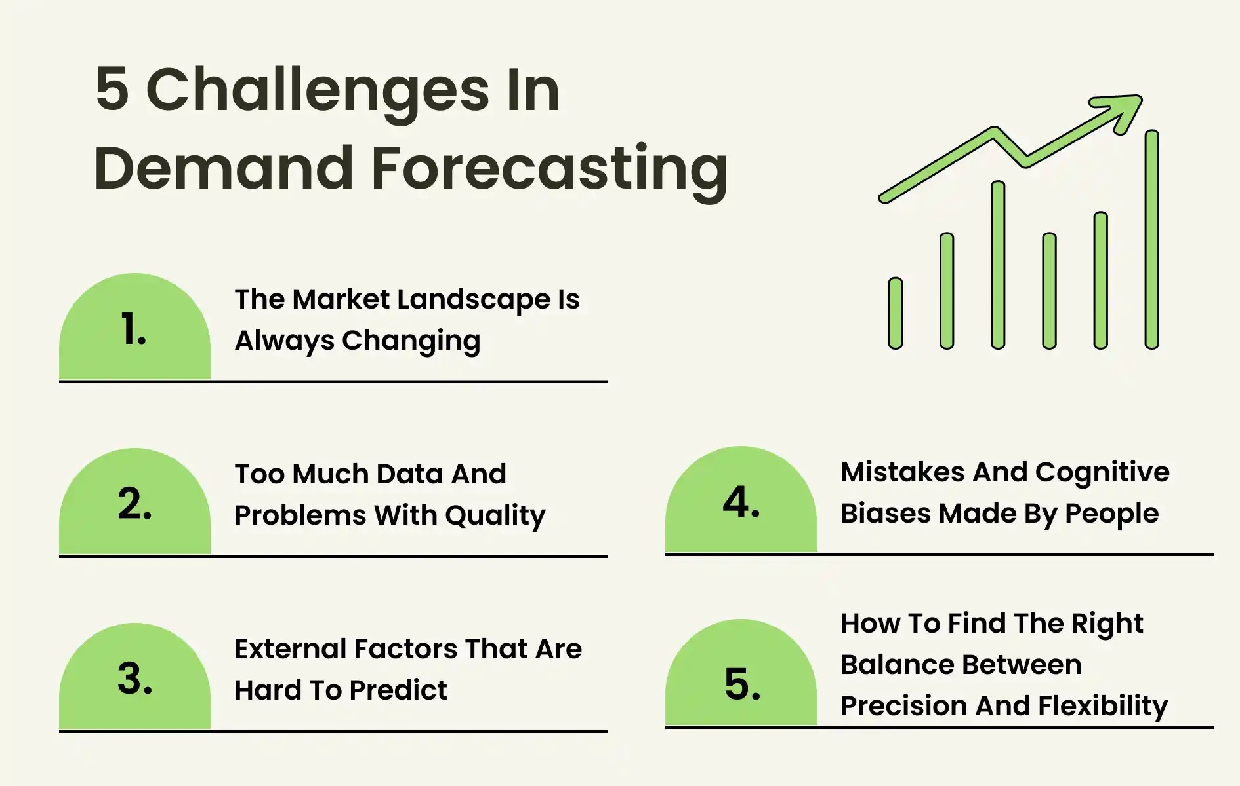
Challenges in Commodity Price Forecasting

Slide 4




Methodology Overview
Data Collection
Exploratory Analysis
Model Development

Slide 5
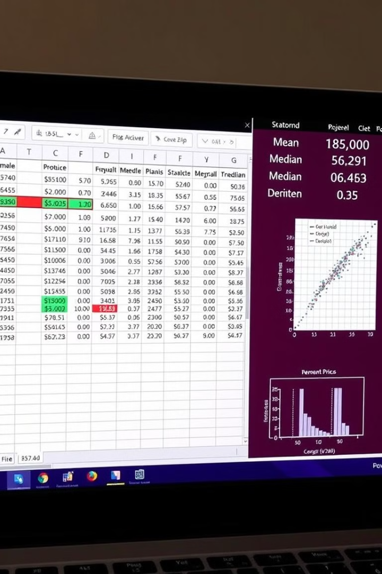
Data Collection and Preparation
1
Historical price data for each commodity will be collected from reputable sources.
2
Data cleaning includes handling missing values, outliers, and inconsistencies to ensure accuracy.
3
Data preprocessing may involve transformations to standardize data for analysis and modeling.

Slide 6
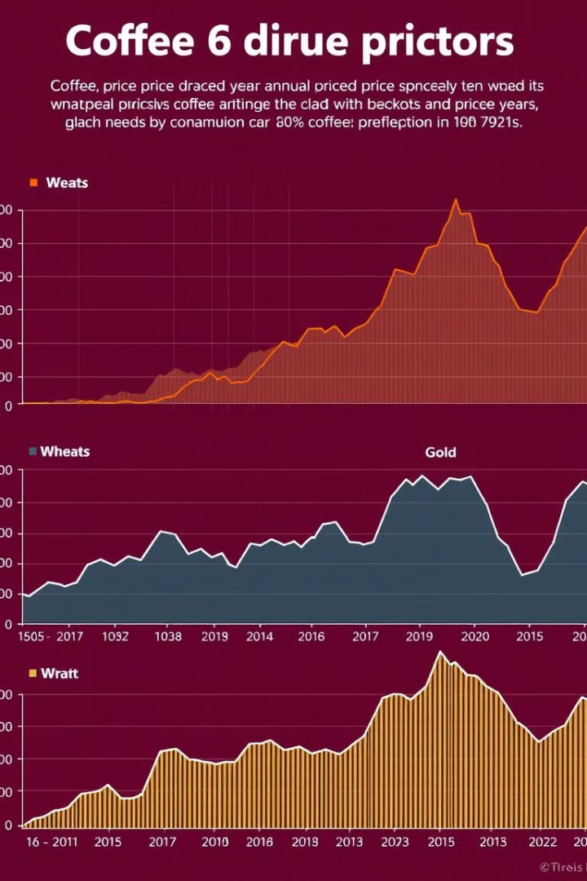



Exploratory Data Analysis (EDA)
Visualizing annual price trajectories to identify long-term trends and seasonality.
Grouped data by year will reveal patterns in price movements and volatility over time.
Identifying potential correlations between different commodities and external factors.

Slide 7
Price Trends by Commodity
Gold & Silver
Copper
Palladium & Platinum
Both exhibit long-term trends with periods of high volatility, often moving in tandem.
Copper displays cyclical trends closely tied to industrial demand and economic activity.
These precious metals have experienced sharp price increases in recent years.

Slide 8
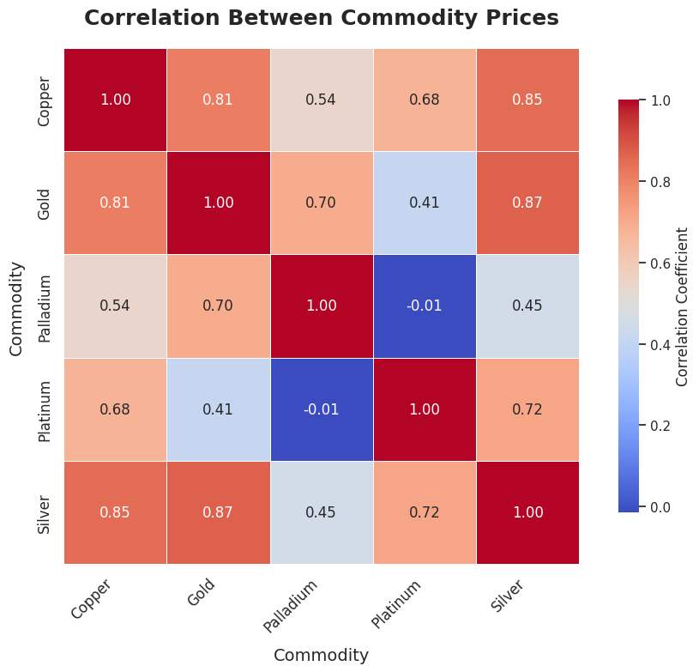
Correlation Analysis
Gold & Silver: Strong positive correlation (~0.85-0.90) due to factors like inflation, investor sentiment, and economic instability.
Copper & Precious Metals: Weaker correlation due to Copper's industrial demand sensitivity vs. Gold/Silver’s ties to financial markets.
Palladium & Platinum: Moderate correlation linked to their use in the automotive industry (catalytic converters).

Slide 9
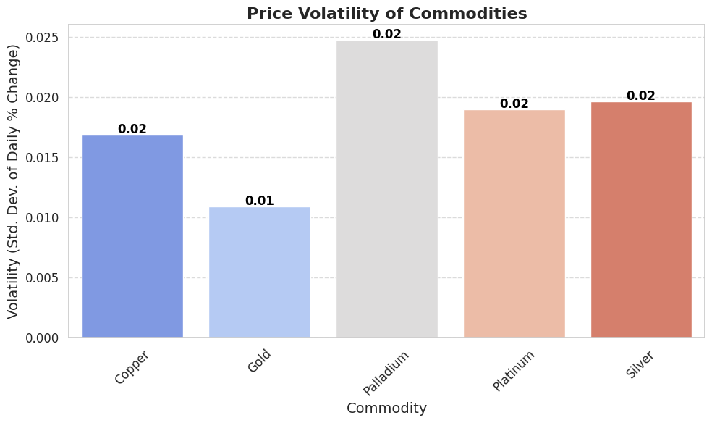
Volatility Analysis
10%
Standard Deviation
The standard deviation of daily percentage changes measures price volatility.
20%
Comparison
Comparing volatility across commodities reveals risk levels and potential for gains or losses.

Slide 10

Predicting Commodity Price Trends: A Deep Dive into ARIMA and Random Forest Models
This presentation explores how statistical and machine learning models can be combined to enhance commodity price forecasting. Through a comprehensive analysis, we'll reveal the key findings and practical applications of our innovative hybrid approach.

Slide 11
Stationarity Testing: Ensuring Model Reliability
ADF Test
Commodity | p-value | Stationarity
Gold | 0.9388 | Non-stationary
Silver | 0.5071 | Non-stationary
Copper | 0.3884 | Non-stationary
Palladium | 0.5622 | Non-stationary
Platinum | 0.1217 | Non-stationary
The Augmented Dickey-Fuller (ADF) test checks for stationarity in time series data, ensuring that the data exhibits constant statistical properties over time. This is a crucial step before building any forecasting model.
Differencing
Differencing is a technique used to transform non-stationary time series into stationary ones. It involves subtracting the value of a series at time t-1 from the value at time t.

Slide 12
Statistical Modeling with ARIMA: Capturing Linear Trends
ARIMA Methodology
Model Diagnostics
ARIMA models capture linear trends and dependencies in time series data. They are defined by three parameters: p (AR), d (I), and q (MA).
After fitting the model, it's crucial to analyze its residuals to assess the model's accuracy and identify potential biases or inconsistencies.

Slide 13
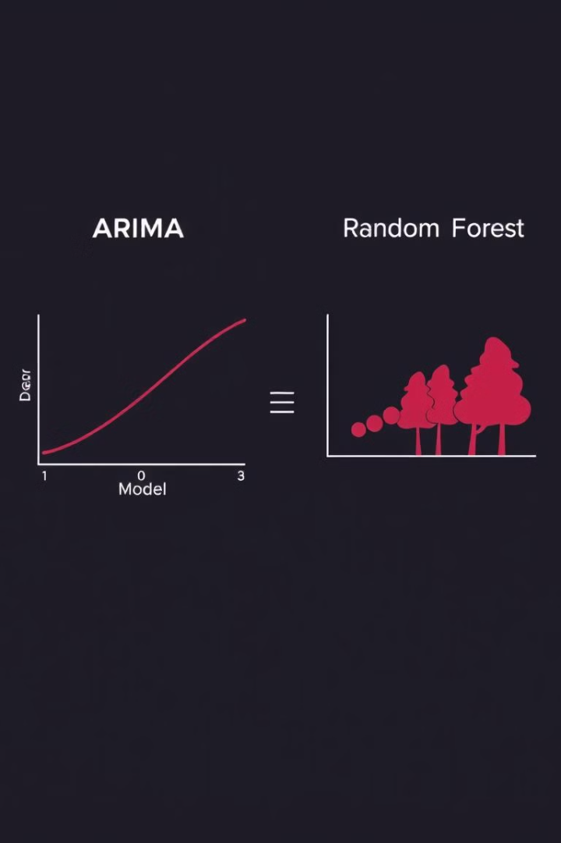
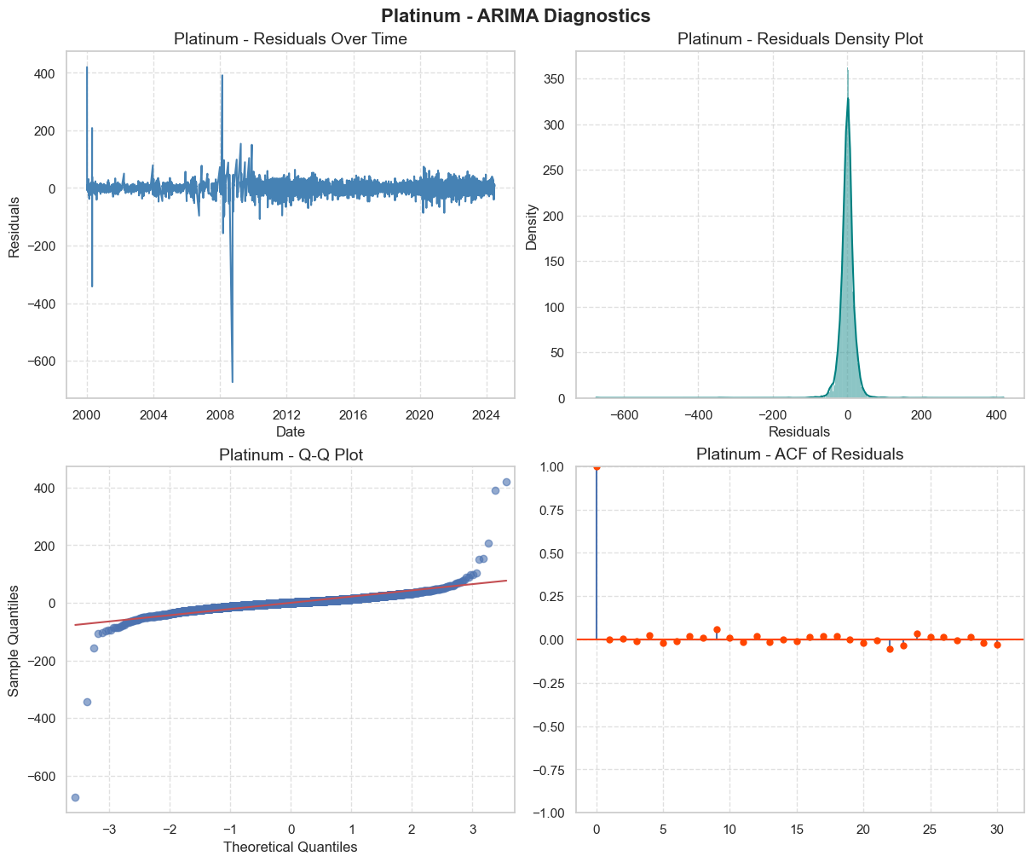
ARIMA : Performance of the Model
1
ARIMA
ARIMA models are best suited for capturing linear trends and seasonal patterns in time series data. They are often used as a baseline model for comparison.
2
Residuals
Residuals in machine learning are the differences between observed values and model predictions, measuring prediction errors to evaluate model performance and guide improvements.
3
Meaning of Plot
The closer is a residual to zero the closer is the prediction to the original value.

Slide 14

Model Performance Evaluation: Comparing the Best
Commodity | RMSE | MAE
Gold | 363.80 | 320.30
Silver | 5.44 | 4.72
Copper | 1.31 | 1.14
Palladium | 549.61 | 467.59
Platinum | 105.79 | 80.40
MAE (Mean Absolute Error)
Measures the average absolute difference between predicted and actual values.
RMSE (Root Mean Squared Error)
Calculates the square root of the average squared difference between predicted and actual values. This metric is sensitive to outliers and can be used to assess the overall accuracy of the model.

Slide 15
Multivariate Modelling using Prophet
Model Diagnostics
PROPHET Methodology
PROPHET is a procedure for forecasting time series data based on an additive model where non-linear trends are fit with yearly, weekly, and daily seasonality, plus holiday effects.
After Prophet includes functionality for time series cross validation to measure forecast error using historical data. This is done by selecting cutoff points in the history, and for each of them fitting the model using data only up to that cutoff point. We can then compare the forecasted values to the actual values.

Slide 16
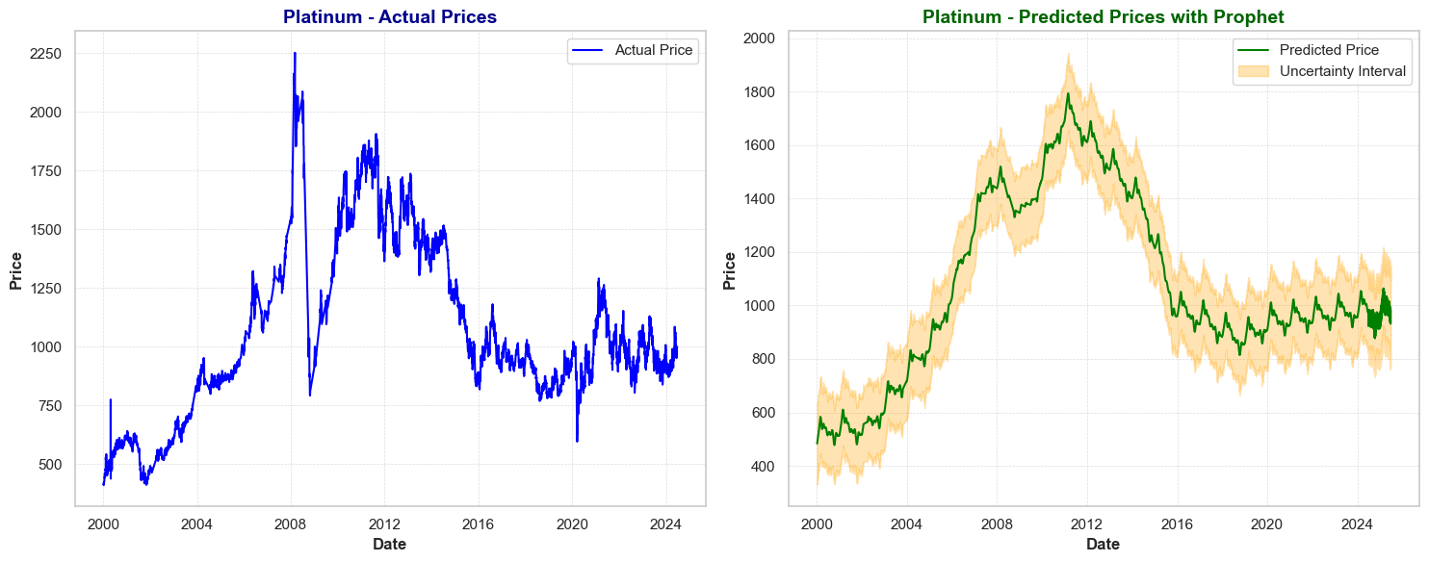
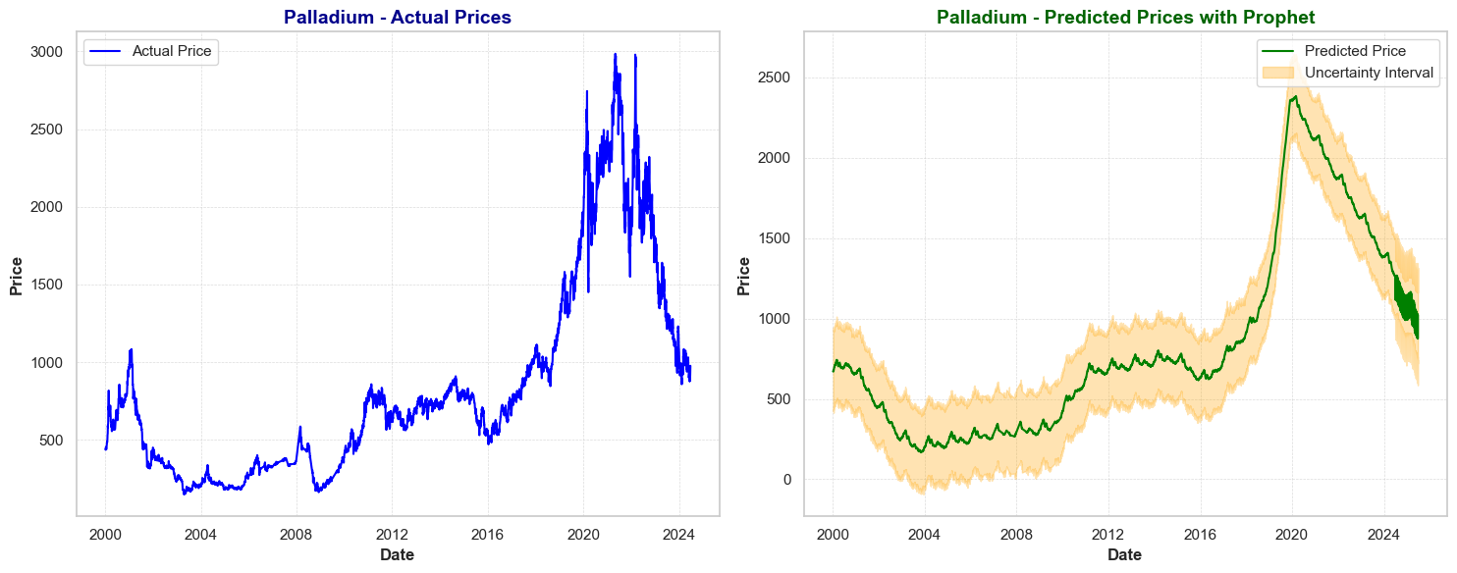
PROPHET: Plots and Significance
Prophet
The left plot shows actual platinum prices over time, while the right displays Prophet's predicted prices with uncertainty intervals.

Slide 17

Long-Short Term Memory- LSTM
The Methodology
Long Short-Term Memory (LSTM) is a recurrent neural network (RNN) architecture that processes sequential data using memory cells, gates (input, forget, output), and hidden states to capture long-term dependencies effectively.

Slide 18
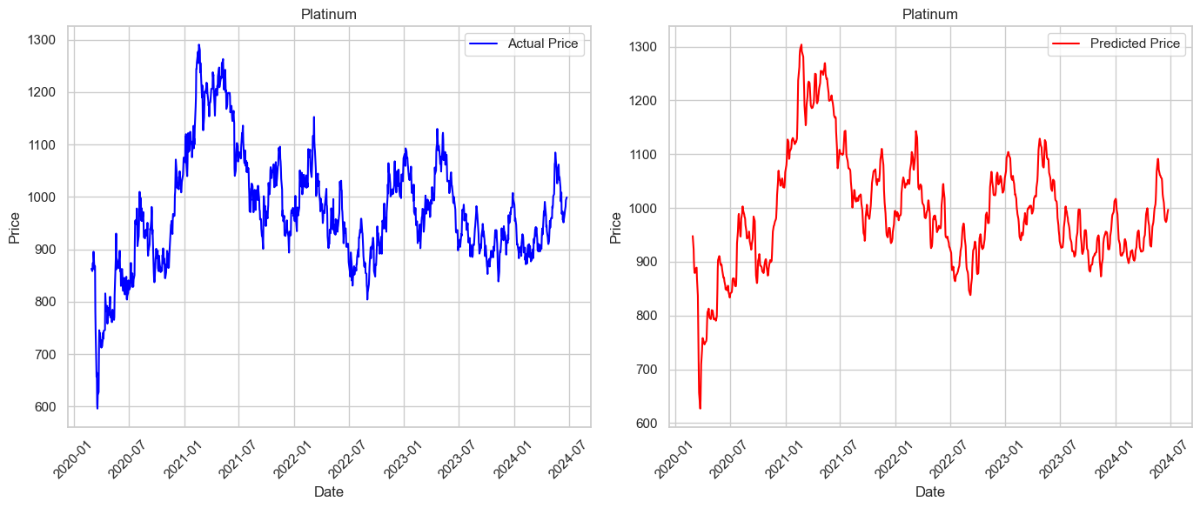
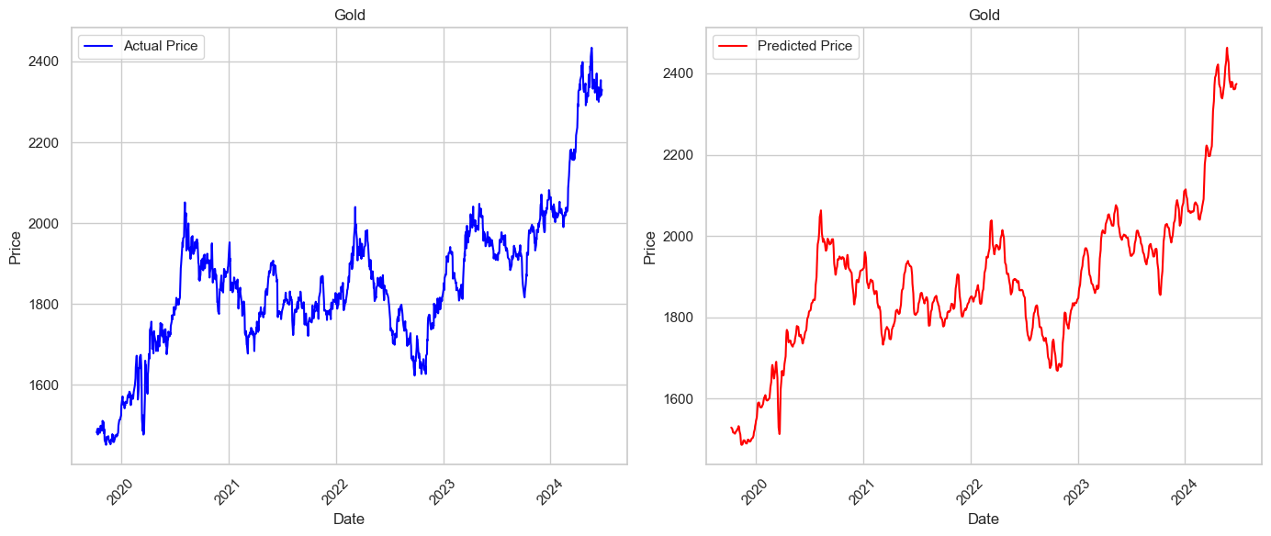
LSTM: Plots and Performance
Both the plot and the evaluation metrics show that the model performs at a very high level with a accuracy percentage close to 96%
Commodity | RMSE | MAPE
Gold | 44.39 | 2.06%
Silver | 0.71 | 2.34%
Copper | 0.09 | 1.84%
Palladium | 93.64 | 3.43%
Platinum | 33.79 | 2.81%

Slide 19



Key Findings: Uncovering Trends in Commodity Prices
Gold
1
The price of Gold is often influenced by global economic uncertainty and acts as a safe haven asset during times of crisis.
Silver
2
The price of Silver is often influenced by industrial demand, with its price fluctuating based on the health of the manufacturing sector.
Copper
3
Copper prices are strongly tied to the global industrial cycle, influenced by the demand for infrastructure projects, construction, and manufacturing.

Slide 20
Key Findings: Unveiling Correlations Between Commodities
Gold-Silver
1
Gold and Silver prices tend to move together, indicating a strong positive correlation. They are both considered precious metals and share similar drivers.
Industrial vs. Precious
The correlations between industrial metals like Copper and precious metals like Gold are generally weaker, implying a less pronounced link between their price movements.
2

Slide 21
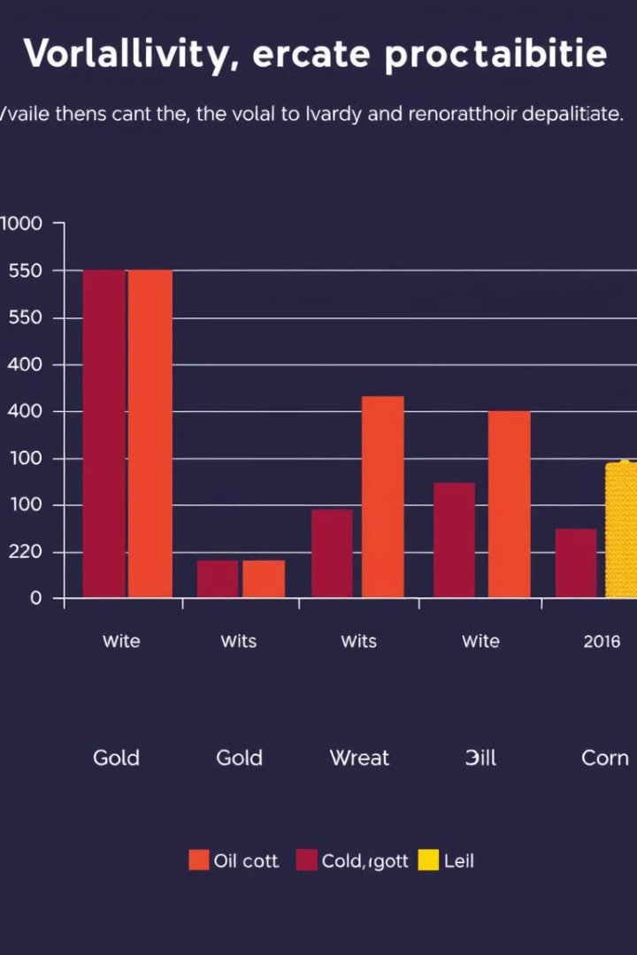
Key Findings: Volatility and Risk Management
1
2
Palladium
Gold
Palladium is known for its high volatility due to its limited supply and significant demand from the automotive industry.
Gold is considered a relatively stable commodity, often acting as a safe haven asset during periods of economic uncertainty.

Slide 22



Conclusion: A Path Forward
Key Findings
1
The study highlights the benefits and limitations of using hybrid models for commodity price forecasting.
Value Proposition
2
The integration of traditional and modern methods offers a powerful tool for stakeholders in the global market.
Future Research
3
Further research is crucial to address the limitations and refine the model for greater accuracy and real-time applications.

